Slide 1
MODERNIZED DATA FOUNDATION (MDF)
Q&A Trade Description
29 January 2024
Copyright © 2023 Accenture confidential. All Rights Reserved

Slide 2
Agenda
Contingent New trade
New Trade
Trade Navigator

Slide 3
Agenda
Contingent New trade
New Trade
Trade Navigator

Slide 4
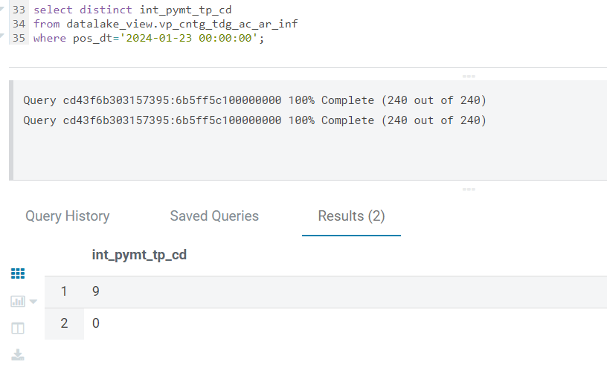
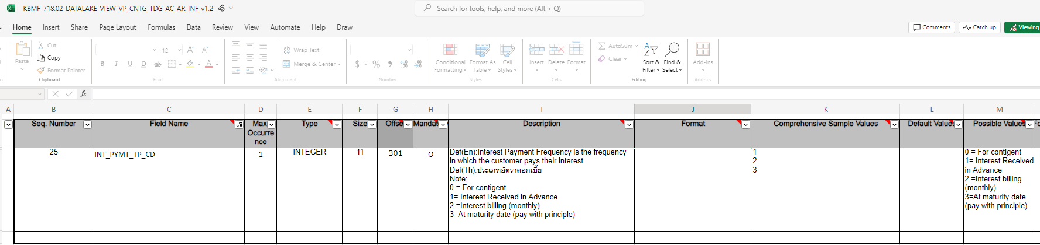
Contingent New trade : int_PYMT_TP_CD
Question | Answer
Please clarify meaning ‘9’ and description of its | Pending EBAN to further check

Slide 5
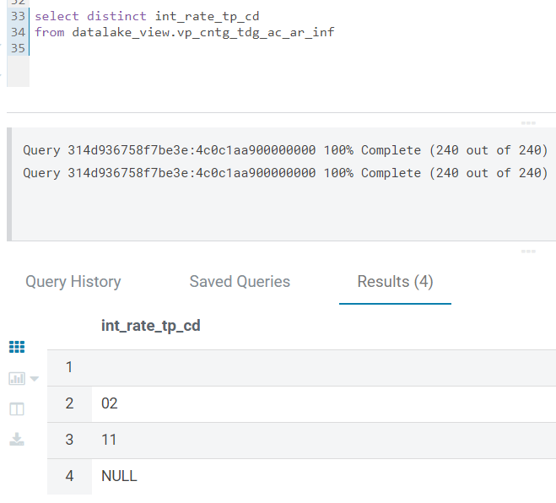
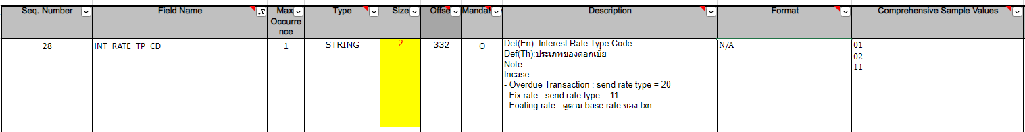
Contingent New trade : int_RATE_TP_CD
Question | Answer
Please clarify meaning ‘02’ and description of its Now it has only ‘02’ and ‘11’ ? | Pending EBAN to further check

Slide 6
Agenda
Contingent New trade
New Trade
Trade Navigator

Slide 7
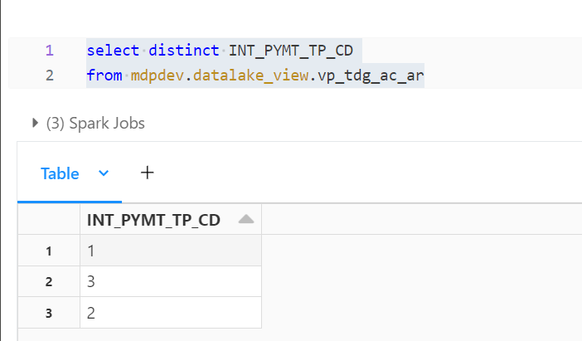
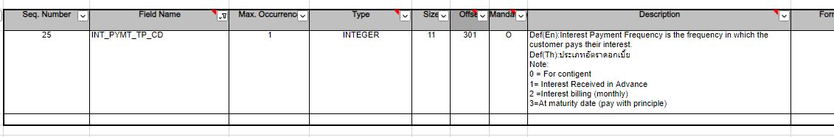
New trade : int_PYMT_TP_CD
Question | Answer
Description can be referred from KBMF? | Confirmed that could refer from KBMF

Slide 8
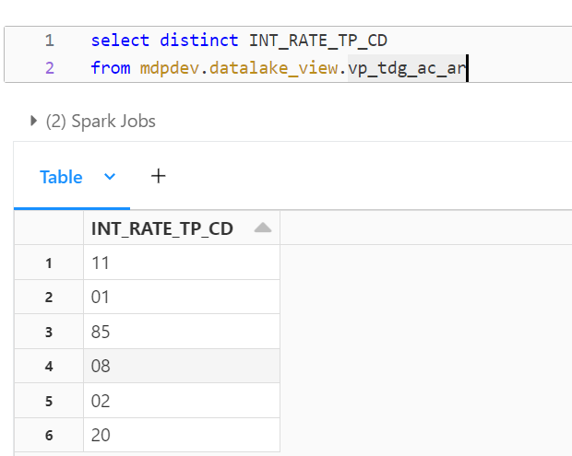
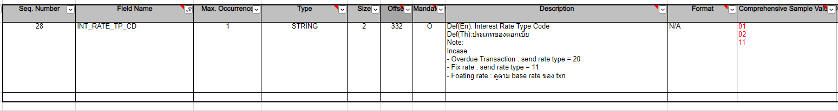
New trade : int_RATE_TP_CD
Question | Answer
Can you clarify meaning and description of values which is not displayed in KBMF? | Pending EBAN to further check

Slide 9
Agenda
Contingent New trade
New Trade
Trade Navigator

Slide 10
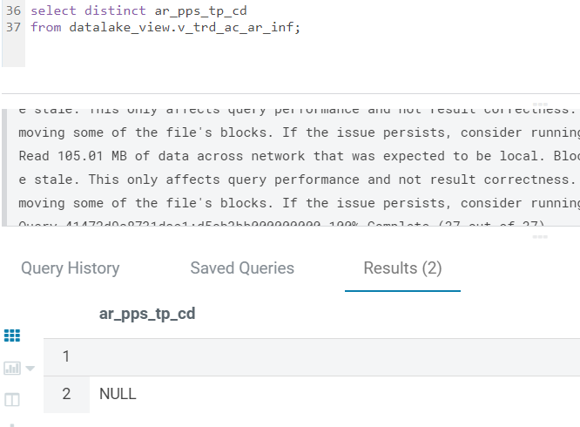
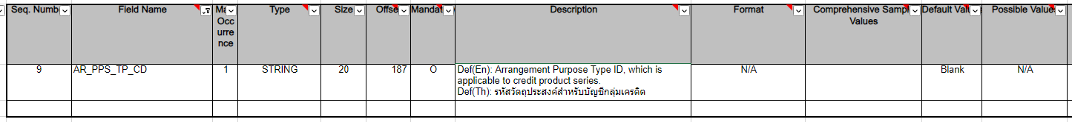
Trade navigator : AR_PPS_TP_CD
Question | Answer
Now, this value is not to use? and/or send default value blank referred from KBMF? What description? (CBR logic : Trim and Direct Move from source file) | The value could be referred from KBMF It’s not description

Slide 11
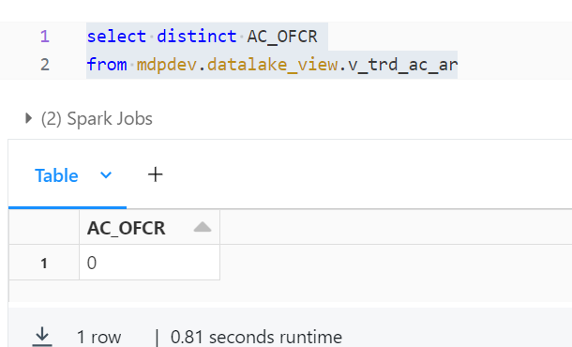
Trade navigator : AC_OFCR
Question | Answer
Please clarify meaning ‘0’ and description of its | Pending EBAN to further check

Slide 12
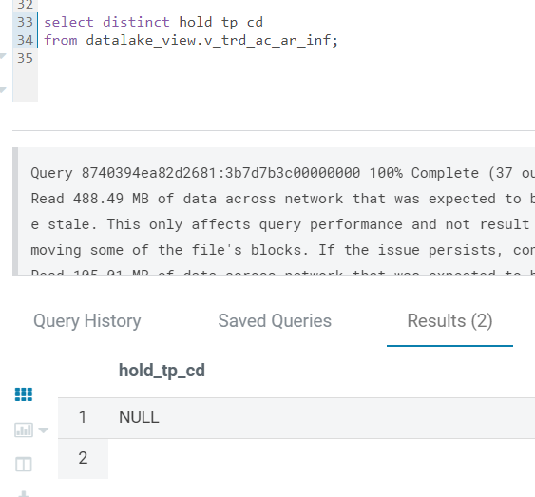
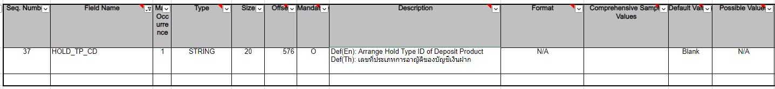
Trade navigator : hold_TP_CD
Question | Answer
Now, this value is not to use? and/or send default value blank referred from KBMF? What description? (CBR logic : Trim and Direct Move from source file) | The value could be referred from KBMF It’s not description

Slide 13
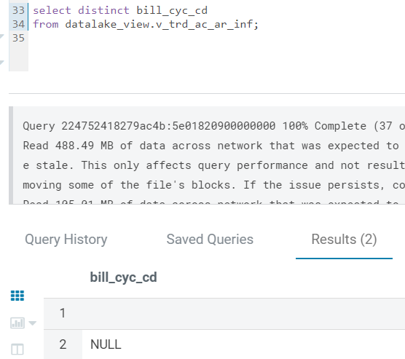
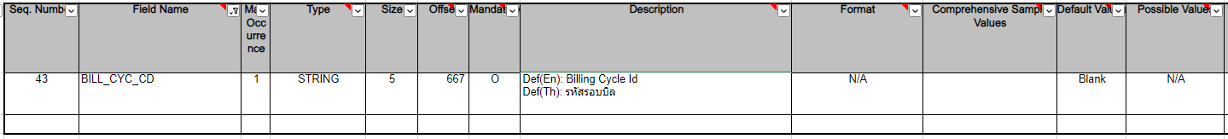
Trade navigator : bill_CYC_CD
Question | Answer
Now, this value is not to use? and/or send default value blank referred from KBMF? What description? (CBR logic : Trim and Direct Move from source file) | The value could be referred from KBMF It’s not description

Slide 14
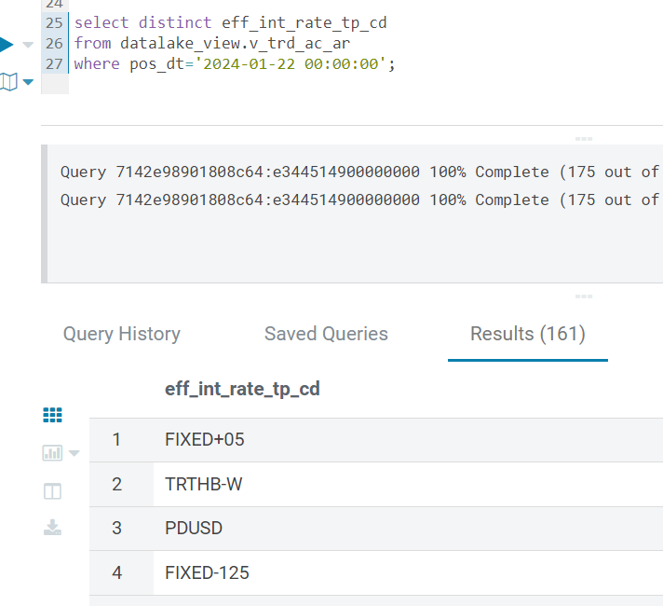
Trade navigator : EFF_INT_RATE_TP_CD
Question | Answer
Can you provide or recommend description file/source for mapping this field? | Pending EBAN to further check

Slide 15
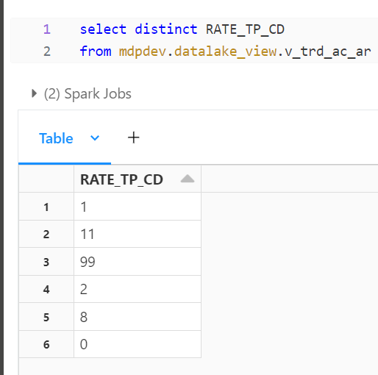
Trade navigator : RATE_TP_CD
Question | Answer
Can you provide or recommend description file/source for mapping this field? | Pending EBAN to further check

Slide 16
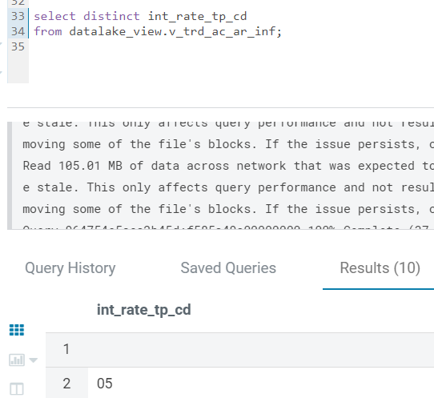
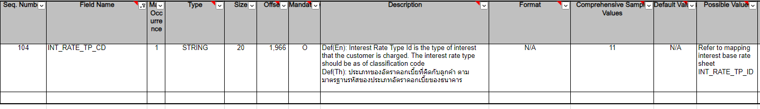
Trade navigator : INT_RATE_TP_CD
Question | Answer
Can you provide or recommend description file/source for mapping this field? What different between RATE_TP_CD and INT_RATE_TP_CD? It is the same thing? | Pending EBAN to further check
int_rate_tp_cd
05
11
08
20
07
01
NULL
02
21

Slide 17
THE End
Copyright © 2022 Accenture confidential. All Rights Reserved

